Slide 1
Buffer Overflow Attack
by Boris Chernis

Slide 2
Introduction
What is hacking?
Getting a system to do things other than what the developer intended.
2 ways to hack a program
Patch it (modifying the source code or assembly code). Example: Cracking a program that asks you for a serial key
Buffer overflow: Make a program do crazy things by giving it crazy inputs.
What are examples of inputs?
Standard input (stuff you either type in and hit ENTER or read from an input file)
Messages exchanged in a protocol. Example: Your browser sends a “GET” request to a web server (a computer running http on port 80 or https on port 443). Web server responds with a web page (a text file with HTML code) for your browser to render.
So how “crazy” are we talking?
https://www.youtube.com/watch?v=FkQdwUns7H8

Slide 3
Background Info: Compilation/assembly
When people say “compile”, they usually mean “compile and assemble”.
Assembly instructions are usually directly translatable to machine instructions, and vise-versa, so the two terms are often used interchangeably.
We rarely look at machine code, because assembly is much easier to read. We will see an exception to this rule.
Side note: A popular command for disassembling an executable is objdump –d myExecutable
source code
compile
decompile
assembly instructions
assemble
disassemble
machine instructions (executable)
Often rendered as hex (instead of binary) for slightly better readability. How do we know if a number is being rendered as hex?

Slide 4
Background Info: Number systems
Many people do not realize that 1) there is more than 1 way to represent numbers, and 2) there is nothing inherently special about our number 10 (it is simply the number of fingers that we have).
If humans had 4 fingers on each hand instead of 5, then 4+4 would be 10, the digits 8 and 9 would not exist, and we would be counting as follows: 1,2,3,4,5,6,7,10,11,...,17,20,…,30,…,40,…,50,…60,...,70,71,72,73,74,75,76,77,100,…,175,176,177,200,…,775,776,777,1000,…
We would refer to this system as regular Base 10 and teach it to kindergarteners, and if we discovered a civilization with 5 fingers on each hand, we would notice that they use Base 12. From their perspective, we would obviously be using Base 8.

Slide 5
Background Info: Hex
Decimal | Binary | Hex
0 | 0 | 0
1 | 1 | 1
2 | 10 | 2
3 | 11 | 3
4 | 100 | 4
5 | 101 | 5
6 | 110 | 6
7 | 111 | 7
8 | 1000 | 8
9 | 1001 | 9
10 | 1010 | a
11 | 1011 | b
12 | 1100 | c
13 | 1101 | d
14 | 1110 | e
15 | 1111 | f
16 | 10000 | 10
17 | 10001 | 11
18 | 10002 | 12
Hex (short for hexadecimal) is a number system with 16 digits.
Because 16 is an exponent of 2, it is VERY easy to manually convert from hex to binary and back.
Therefore, hex is used as a shorter and (usually) more readable representation of binary.
Any time we see “0x”, we know that whatever follows is hex.
Example:
0x123 is hex 123, or decimal 1*16²+2*16¹+3*16⁰=291

Slide 6
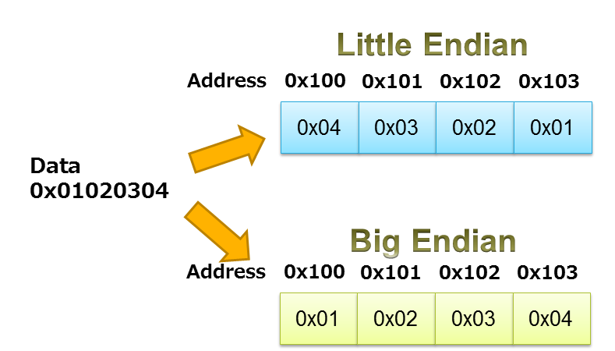
Background Info: Endianness
A single byte does not contain enough information to store an address. We need a “word”.
A word is 4 bytes in 32-bit architecture and 8 bytes in 64-bit architecture. In “big endian”, the bytes in a word are ordered as we would expect, but in “little endian”, the byte order is reversed.
Kali Linux is little endian.
Important: Each byte can be represented by 8 bits or 2 hex digits. The bit or hex digit order within each byte does not change.

Slide 7
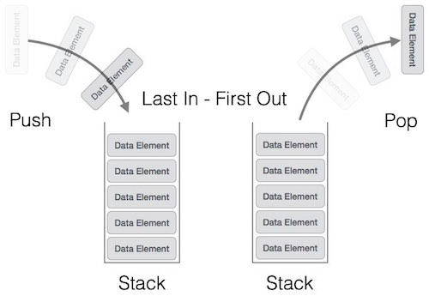
Background Info: What is a stack?
A VERY important data structure in computer science.
Stacks are LIFO.

Slide 8
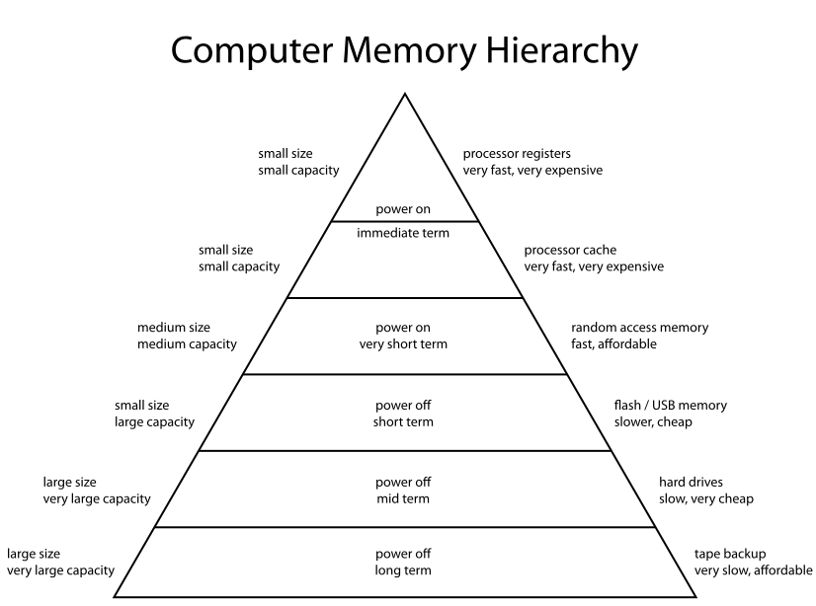
Background Info: What are registers?
https://en.wikipedia.org/wiki/Memory_hierarchy

Slide 9
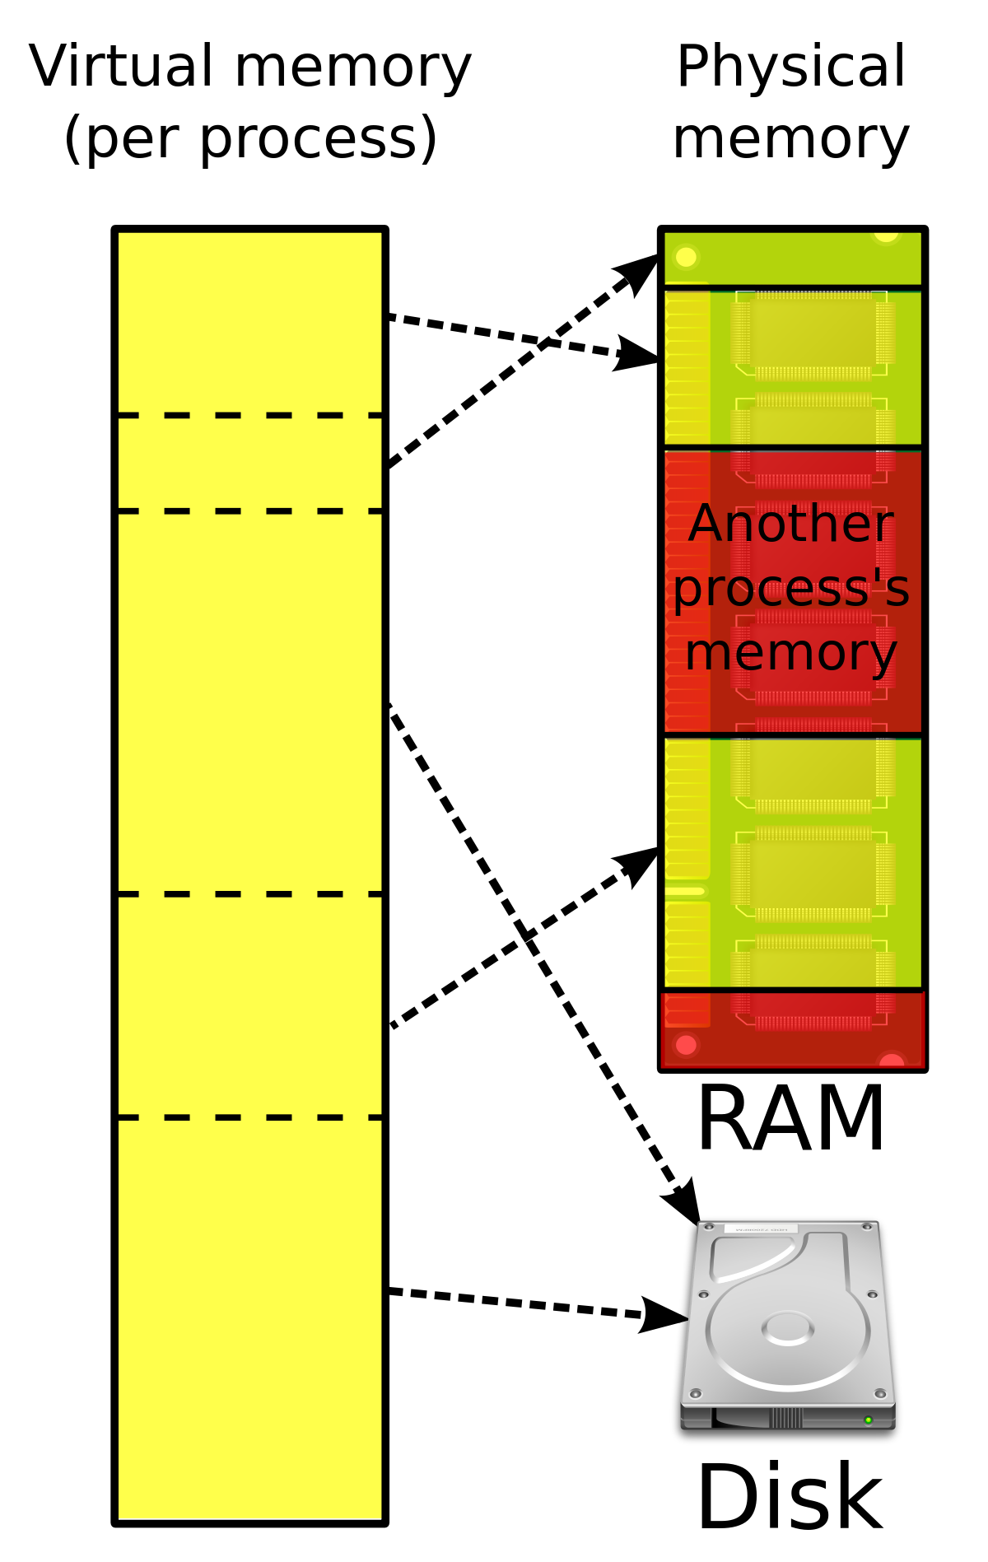
Virtual Memory
Each process thinks it has access to the entire memory of the machine.
Each time a program is run, its physical address layout might change, but the virtual addresses will be consistent. We (hackers) can take advantage of this.
Not completely true, because modern OSes use ASLR, but that is beyond the scope of this lecture.

Slide 10
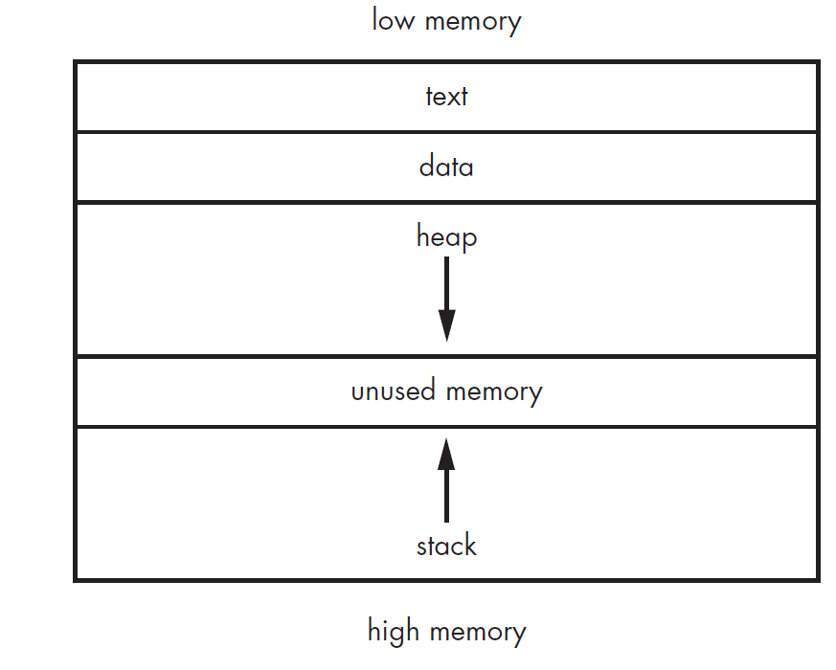
Let’s zoom in to a process
A “process” is defined as a running program.
In the diagram to the right, we (hackers) are most interested in the “stack”. Heap-based exploits exist as well, but they are more difficult to perform.
instructions (machine code)
global variables
dynamic memory allocation
local variables and return addresses

Slide 11
Let’s zoom in to the stack
The stack stores local variables and return addresses.
What is a “return address”?
Let’s say f1() calls f2(). F1’s return address is the only way the CPU knows where to pick back up in f1() after f2() encounters a “return” statement.
Each time one subroutine calls another, a “stack frame” is pushed to the top of the stack.
Each time a return statement is executed, a stack frame is popped off the top of the stack.
The next 5 slides describe how function calls and returns work. Prepare to become thoroughly confused.

Slide 12
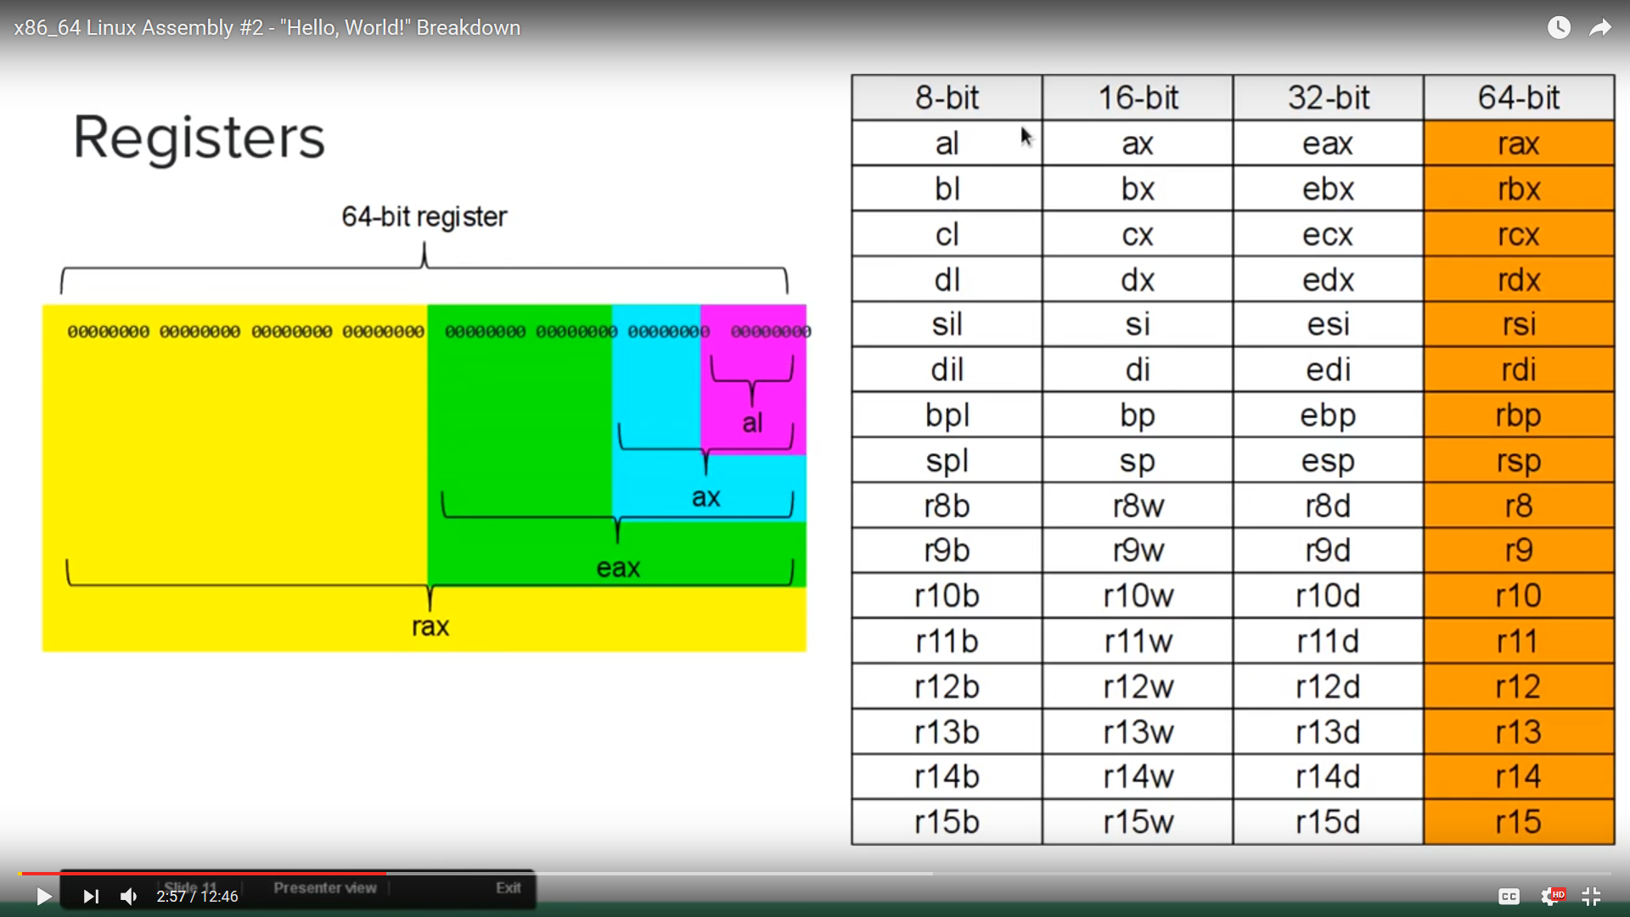
3 important registers in 32-bit architecture
In 32-bit architecture:
EIP (instruction pointer): Stores address of next instruction to be executed.
ESP (stack pointer): Stores the top (lowest) address of the top stack frame.
EBP (base pointer): Stores the bottom (highest) address of the top stack frame.
In 64-bit architecture:
The registers are RIP, RSP, and RBP. EIP, ESP, and EBP are the least-significant 32 bits of the corresponding 64-bit registers. The screenshot on the right is from a YouTube video.

Slide 13
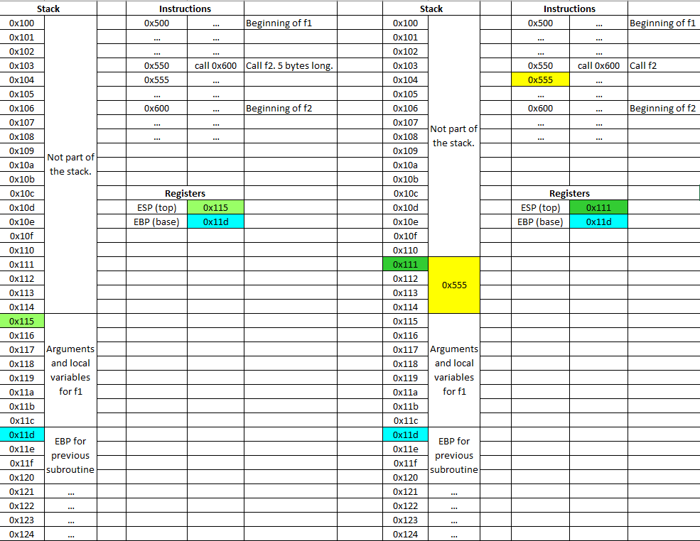
f1 calls f2
Note: The addresses of the “Instructions” should technically be lower than the addresses in the stack (see process diagram slide). I just didn’t feel like making any more edits.
Before
After
Let’s say subroutine f1 calls subroutine f2.
When f1 calls f2, the “call” instruction pushes the address of the next instruction of f1 (the “return address”) onto the stack and then changes the EIP to the address of the first instruction of f2.
Note: Any time we have a “push” or “pop” instruction, ESP gets adjusted automatically.

Slide 14
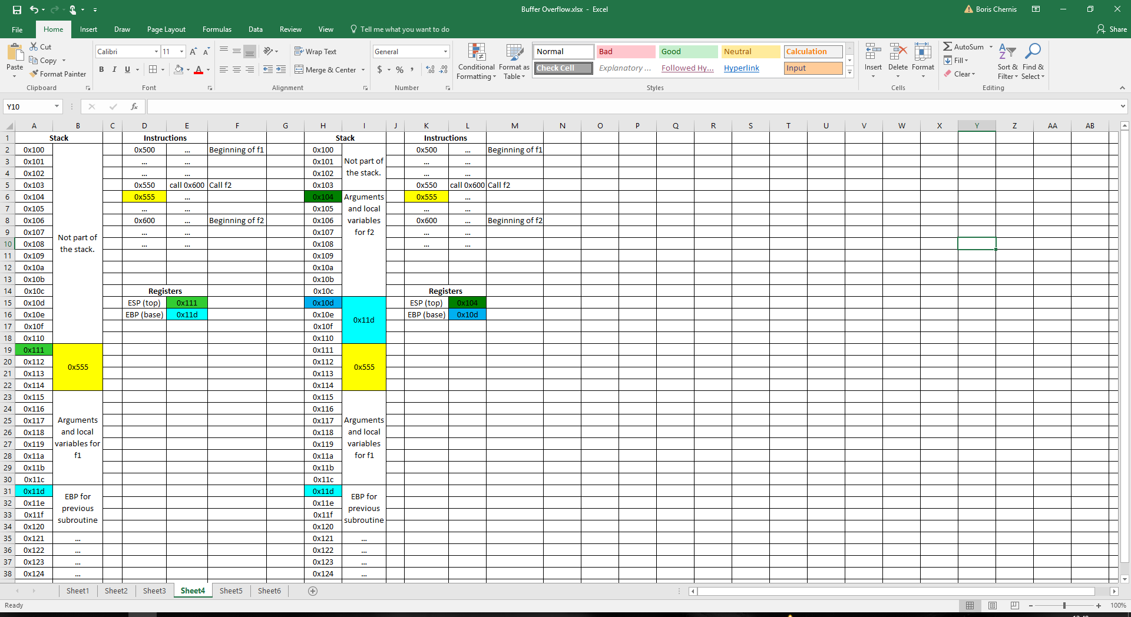
Prologue of f2
Before
After
The first 3 instructions of a subroutine, called the “prologue”, make ESP and EBP point to the top and bottom of the next stack frame.
The size of the stack frame depends on the arguments and local variables that it must hold.
The bottom of a new stack frame, pointed to by EBP, holds the previous EBP value (bottom of previous stack frame).
f2 stack frame
4-byte return address
f1 stack frame

Slide 15
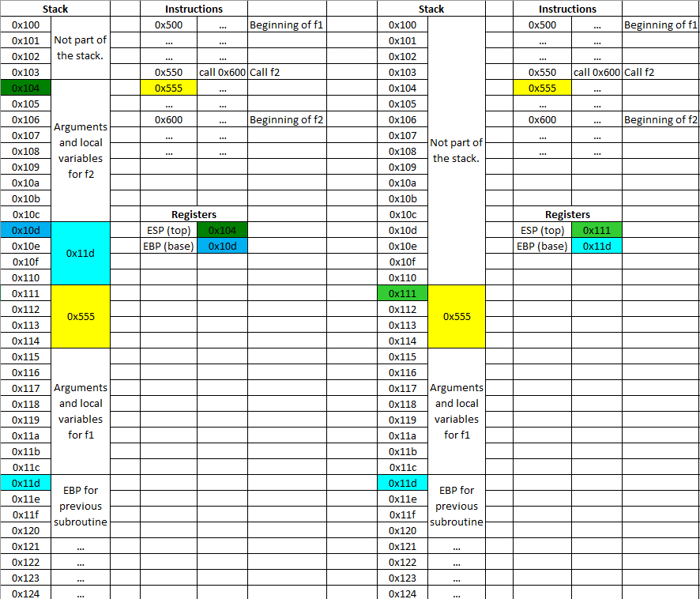
Epilogue of f2
Before
After
Functions have “epilogues” (3-instruction sequences preceding their return statements).
An epilogue reverses the prologue.
EBP is copied to ESP (this leaves only the bottom 4 bytes of the old stack frame, containing previous EBP value) and then pops that value into EBP.

Slide 16
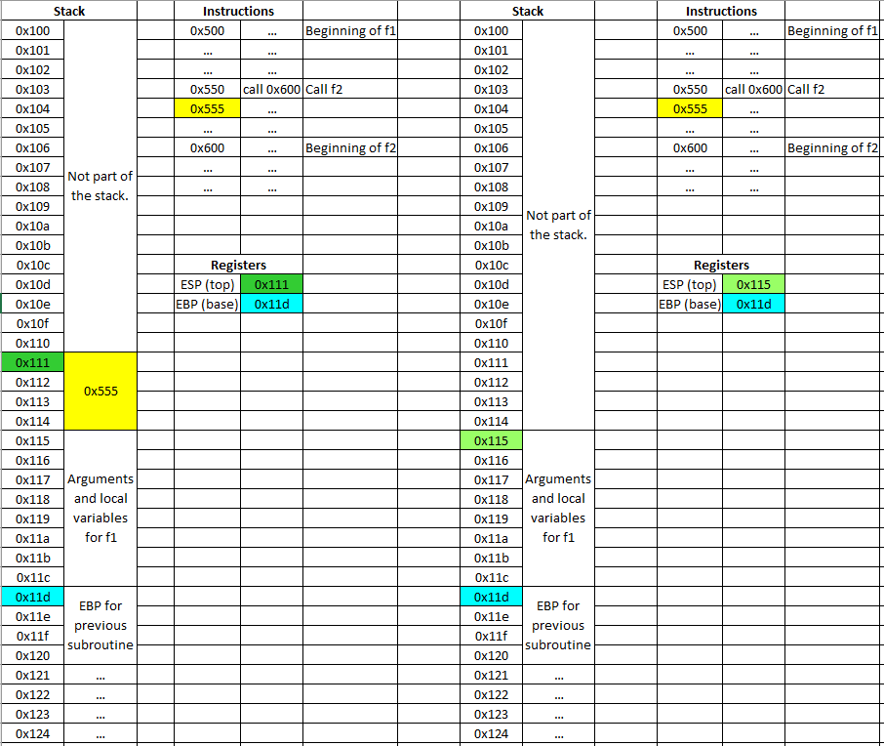
Return from f2 to f1
Before
After
Reverses the “call” instruction.
Return address is popped, and EIP is changed to the return address.

Slide 17
Confused?
If you want to understand stack frames better, do the following:
There is a short wiki page describing function prologue/epilogue.
Write a simple C program with a few function calls. You will see the same prologues and epilogues in the disassembled code as on the wiki page. Step through the instructions, and watch the memory and registers change. For this, you’ll need to learn how to use a debugger (see References slide).
Main takeaway: Return addresses are important!!

Slide 18
So how do we get our hands dirty?
We can make a program deviate from its intended path by overwriting a return address.
Wannabes use:
msfconsole: In the Metasploit framework, you simply select an exploit (based on vulnerability information you found with nmap), set RHOST to the target’s IP address, and type “exploit”. The exploits in Metasploit are pre-written, so this requires no knowledge of computer science whatsoever.
But what if you want to write your own exploits?
All the cool kids use debuggers.
gdb: A Linux debugger
Ollydbg: A Windows debugger

Slide 19
What is a debugger?
Shows you exactly what’s going on in the computer memory and registers at each step in the program execution. This is absolutely essential for software reverse engineering.
A debugger can help you understand how a programming language works.
Finally, a debugger is a very useful debugging tool. Cause let’s face it—print statements suck.
Yes, this means do yourself a favor, go on YouTube, and learn how to use the debugger that’s built into your IDE. Do NOT take Data Structures or OS without first learning how to use your debugger!!!

Slide 20
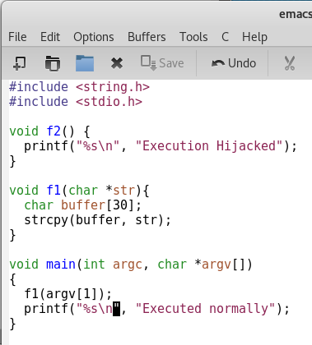
Attack 1: Redirection
Our goal is to make f1() to f2 instead of back to main().
Note that the input to this function is a command-line argument (something you type right after the executable name).
Normally, you would type programName someword to run the program, and see the output “Executed normally”.
But since we’re hackers, we want to type something crazy and get the output “Execution Hijacked”.

Slide 21
Attack 1: Redirection
gcc -g -o executableFile sourceCode.c
-o stands for “output”
If you do not include the “-g” flag, gdb will not be able to map the assembly instructions to the source code when you are debugging.
./executableFile #Run the executable. #Note: If “.” is included in your PATH variable, then the “./” part is optional.
gdb executableFile #Run executable in gdb

Slide 22
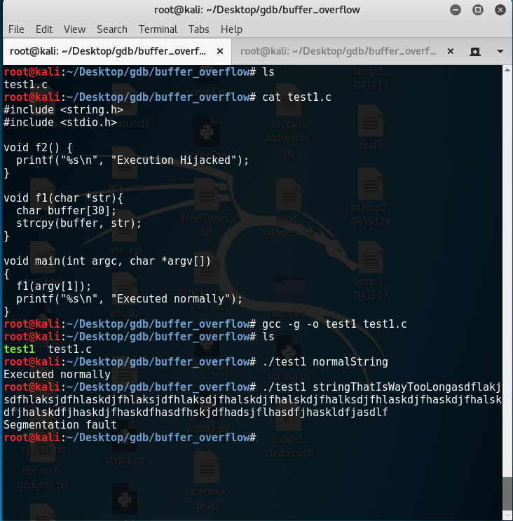
Attack 1: Redirection
Important: This demo is for 64-bit Linux (not 32-bit).
First, we notice that if our input is too long, we get a seg fault. This is because our string went beyond its buffer and overwrote the return address with something that probably does not exist in the memory space. This is actually the simplest form of the buffer overflow attack, although it does not give us any control of the program.
To be able to overwrite the return address with what we want, we must first know where it is sitting.

Slide 23
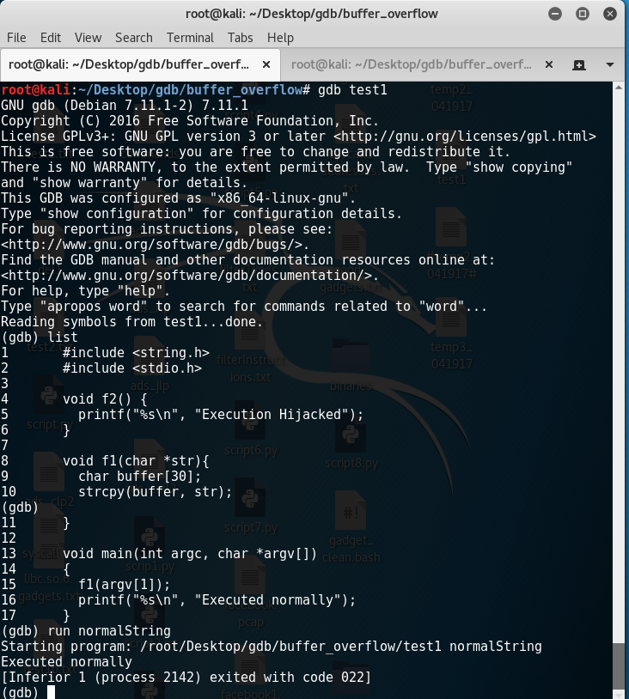
Attack 1: Redirection
We first load the program into gdb.
To see the source code with line numbers (provided you compiled with the –g option), simply type list and keep hitting enter.
To run the program, simply type run, followed by any arguments.

Slide 24
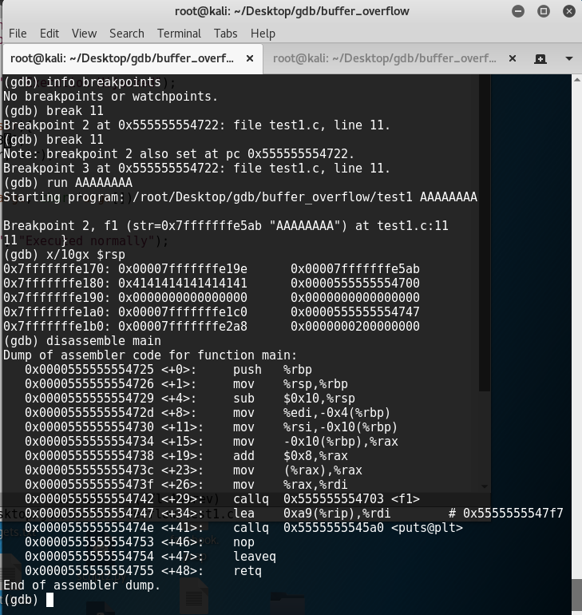
Attack 1: Redirection
We want to see exactly what the stack looks like immediately after the strcpy function runs.
Since strcpy is at line 10 of the source code, so we set our breakpoint at line 11.
We run the program with an input of 8 “A”s. It obviously stops at the breakpoint.
x/10gx $rsp means “Examine 10 gigantic words starting from the top of the stack, and render in hex format”. “Gigantic” means 64 bits instead of 32 bits. For more info on the x command, you can always type help x.
We immediately identify the repeating “41”s as our string of “A”s (ASCII value of “A” is 65=0x41).
In order to check which of the values on the stack is the return address, we disassemble main(). Our return address turns out to be 0x0000555555554747.
After a little bit of counting, we see that in order to overwrite the return address, we need 32 more characters (we can simply use 8+32=40 A’s), followed by whatever address we want to overwrite it with.
The next step is to find that address.
Main calls f1()

Slide 25
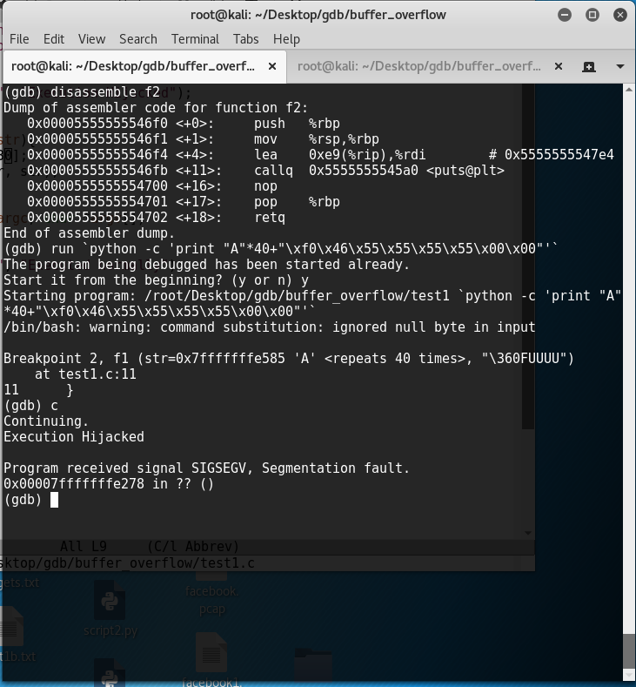
Attack 1: Redirection
Since we want f2’s address in place of our main’s return address, we disassemble f2.
The value we see is 0x0005555555546f0.
We concatenate this address with 40 “A”s, without forgetting to reverse the bytes in the address (little endian, remember?)
PS: The \x notation is how we specify characters by their ASCII codes. A character is 8 bits, but we obviously do NOT have 2⁸ characters on our keyboard, so using ASCII codes is necessary. And yes, instead of the capital A, we could have typed \x41.
PPS: If you don’t understand what python –c is or why the backticks are there, you better google it. You said you wanted to become a hacker, right?
PPPS: Instead of `…`, we could have also typed $(…).

Slide 26
Ignore this slide
Before
After
 |  |  | Address | Content |  |  | Address | Content
Top of stack frame |  | ESP-> | 0x123 | Arguments and local variables are stored in memory addresses ranging from 0x123 to 0x12c. |  | ESP-> | 0x123 | your
 |  |  | 0x124 |  |  |  | 0x124 | nefarious
 |  |  | 0x125 |  |  |  | 0x125 | machine
 |  |  | 0x126 |  |  |  | 0x126 | code
 |  |  | 0x127 |  |  |  | 0x127 | A | This string makes the shellcode length match the stack frame length.
 |  |  | 0x128 |  |  |  | 0x128 | A
 |  |  | 0x129 |  |  |  | 0x129 | A
 |  |  | 0x12a |  |  |  | 0x12a | A
 |  |  | 0x12b |  |  |  | 0x12b | A
Bottom of stack frame |  | EBP-> | 0x12c |  |  | EBP-> | 0x12c | A
 |  |  | 0x12d | Good return address pointing back to whichever subroutine called this subroutine. |  |  | 0x12d | 0x123 | Shady return address pointing to the top of the stack (beginning of your code)

Slide 27
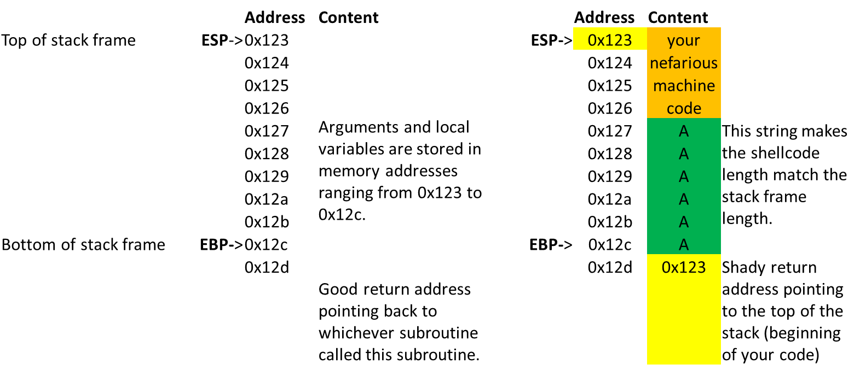
Attack 2: Taking over the machine
Here, we will perform the most widely recognized form of the buffer overflow attack.
We will simply inject machine code into the stack and make the return address point to the start of our code. Since this will give us a command prompt (shell), we refer to is as a “shellcode”.
Before
After

Slide 28
Attack 2: Taking over the machine (cont’d)
Every system call has an ID and up to 6 arguments, stored in registers (see table on the right). We will use the execve system call, which has 3 arguments.
Set rax equal to 0x3b (59 in decimal).
Write “/bin/sh\0” somewhere onto the stack, and set rdi equal to the address of the first character of that string.
Set rsi and rdx equal to 0.
Once everything above is set up, run the instruction int 0x80 or syscall (This switches the CPU to “kernel mode” and runs a system call.)
Differences in 32-bit Linux:
Use eax, ebx, ecx, and edx (see table)
Set eax equal to 11, not 59.
Must use int 0x80 (syscall does not work).
 | 32-bit | 64-bit
Syscall ID | eax | rax
Arg 1 | ebx | rdi
Arg 2 | ecx | rsi
Arg 3 | edx | rdx
Arg 4 | esi | r10
Arg 5 | edi | r8
Arg 6 | ebp | r9
Fun fact: “/bin/sh” is something you could type into the command line (if “/bin” is in your PATH variable, “sh” by itself would also work as a command). The execve function can be used to run ANY command from a C or C++ program. Example: execve(“cp file1 file2”, 0, 0);

Slide 29
Attack 2: Taking over the machine (cont’d)
Long story short, we need the following registers and memory layout set up right before we run the int 0x80 or syscall instruction:
Register | Contents
rax | 0x3b
rdi | 0x123
rsi | 0x0
rdx | 0x0
Memory Address | Contents
0x122 | whatever
0x123 | / (0x62)
0x124 | b (0x2f)
0x125 | i (0x69)
0x126 | n (0x6e)
0x127 | / (0x62)
0x128 | s (0x73)
0x129 | h (0x68)
0x12a | 0x0 (string terminator)
0x12b | blah
0x12c | blah
0x12d | blah
Note: In case I need to state the obvious, memory addresses will vary from program to program. 0x123 is just a number that I made up.

Slide 30
Attack 2: Taking over the machine (cont’d)
But doesn’t it suck to write complex programs in machine code? So what do we do?
Option 1: Write your program in C, and compile it.
Option 2: Just spawn a shell, and then do whatever you want. We accomplish this by running execve(“/bin/sh”,0,0). This is a very simple system call and does not necessarily need to be written in C. You can write it in assembly or even google shellcodes written by other people. Here, “/bin/sh” serves as the command that you are executing. If you don’t believe me, open up a terminal, and type /bin/sh.
In both cases, we must make sure that our input string contains no null bytes, since string characters past the null terminator are ignored. A null byte is NOT a “0” (ASCII code 48 or 0x30), but a “\x00” (ASCII code 0).
Note that in the previous exercise, we actually had 2 null characters in our string. Fortunately, they were at the END of our string and represented the leading zeroes in our address.

Slide 31
Attack 2: Taking over the machine (cont’d)
The next slide shows a bad shellcode (shell1) and a good shellcode(Shell2). Both were written in assembly language and assembled into machine code using nasm. The machine code was then disassembled using objdump to check for leading zeroes. Pcregrep is just a multiline regex pattern matcher that I used to extract the important part of the code. You probably don't have pcregrep installed, so don't worry about it.
Shell1 follows our shellcode recipe and successfully brings up a shell (see next slide). However, its resulting machine code has null bytes (see next slide), so we can't inject it as an input string.
Shell2 accomplishes the same thing as shell1, but without the null bytes, so we'll use it.
Note: GDB and objdump render assembly code in GAS format, while the assembly I wrote in the emacs windows) is in NASM format. They look slightly different, but do the same thing.

Slide 32
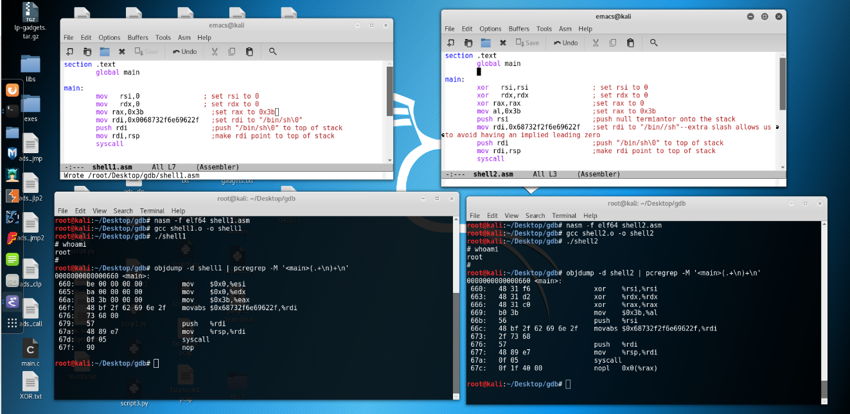
Attack 2: Taking over the machine (cont’d)

Slide 33
Attack 2: Taking over the machine (cont’d)
Modern operating systems and compilers employ various techniques (like ASLR, DEP, and canaries) to protect against the classic buffer overflow attack. What worked for The Girl with the Dragon Tattoo in the year 2000 will NOT work for us in 2017. There are more advanced forms of the buffer overflow attack (such as return-oriented programming), but we're sticking to the basics here, so we must disable the built-in protection.
Disable ASLR
less /proc/sys/kernel/randomize_va_space #It will probably say 2. Hit “q” to exit.
echo "0" > /proc/sys/kernel/randomize_va_space #You could also just vi the file and change the "2" to a "0".
Add some more flags to the gcc command
gcc -g -fno-stack-protector -z execstack -o executableFile sourceCode.c
-fno-stack-protector turns off canary protection
-z execstack turns off DEP

Slide 34
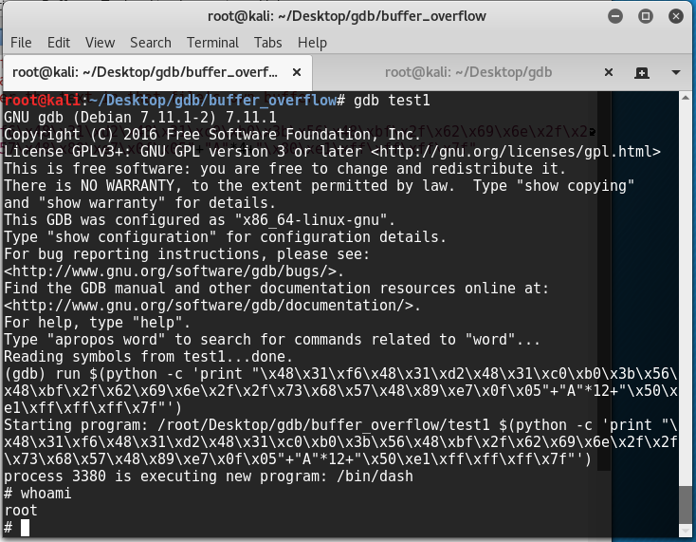
Attack 2: Taking over the machine (cont’d)
Attack 1 and Attack 2 have the same input strength length. Attack 2 has some differences, though.
Difference 1: Some of the "A"s will be replaced with our code (hex values from the objdump output).
Difference 2: The return address will point to the beginning of our code.
As we saw earlier with our x/10gx command, our input string's position in the stack started at 0x00007fffffffe180. However, since we are now compiling the program differently, the address space layout might change. I set a breakpoint and used the "x" feature in the debugger (see earlier slides) to find out the new starting address, which was 0x00007fffffffe150. In the screenshot, we can see that it worked.

Slide 35
Attack 2: The nop sled technique
Let's say we somehow don't have access to the source or executable of the program we are trying to exploit. This means we can't use gdb.
We can easily get the length of the buffer by trying different inputs and determining the minimum length at which we get a seg fault.
In some cases, we don't know the exact address space layout (meaning we don't know the return address), but if the buffer is much longer than our shellcode, we can use nop instructions instead of "A"s. "Nop" means "do nothing and hop to the next instruction". The hex code for nop is \x90.
Yes, we could replace the "A"s with "\x90"s, since "\x90"s are an equally good space filler. But this would give us no advantage over simply using "A"s.
The point is to insert the nops BEFORE our code, not after. We call this a "nop sled".
We can then make our return address point either to the beginning of our code or to ANY NOP INSTRUCTION. If we land on a nop instruction, the CPU will "slide down" the nop sled to the beginning of our code.
The purpose of the nop sled is for us to NOT have to try every single possible return address (since this might take too long). For example, if our nop sled is 1000 nops long, we need only try every 1000th address.
Diagram on next slide.

Slide 36
Ignore this slide
Before
After
 |  |  | Address | Content |  |  | Address | Content
Top of stack frame |  | ESP-> | 0x123 | Arguments and local variables are stored in memory addresses ranging from 0x123 to 0x12c. |  | ESP-> | 0x123 | 0x90
 |  |  | 0x124 |  |  |  | 0x124 | 0x90
 |  |  | 0x125 |  |  |  | 0x125 | 0x90
 |  |  | 0x126 |  |  |  | 0x126 | 0x90 | Nop "sled"
 |  |  | 0x127 |  |  |  | 0x127 | 0x90
 |  |  | 0x128 |  |  |  | 0x128 | 0x90
 |  |  | 0x129 |  |  |  | 0x129 | your
 |  |  | 0x12a |  |  |  | 0x12a | nefarious
 |  |  | 0x12b |  |  |  | 0x12b | machine
Bottom of stack frame |  | EBP-> | 0x12c |  |  | EBP-> | 0x12c | code
 |  |  | 0x12d | Good return address pointing back to whichever subroutine called this subroutine. |  |  | 0x12d | 0x125 | Your shady return address can be anything from 0x123 to 0x129

Slide 37
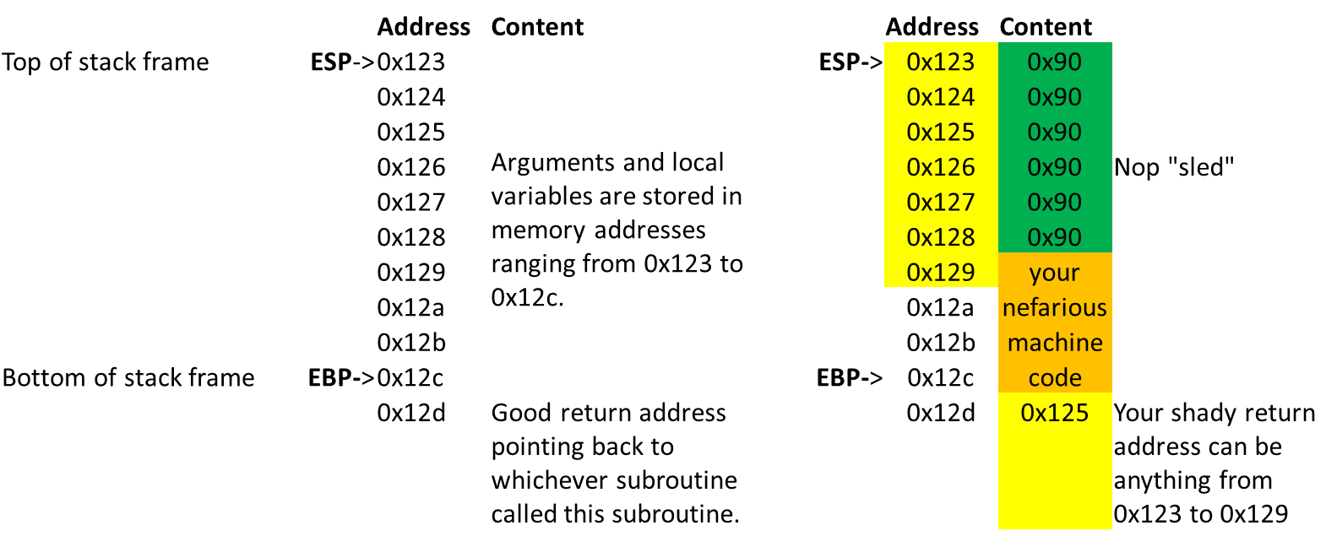
Attack 2: The nop sled (cont'd)
Before
After

Slide 38
History: The buffer overflow “tug-of-war”
Hackers invented the most basic buffer overflow attack (Attack 2 in this powerpoint)
W^X (aka DEP) was implemented, which makes the stack non-executable.
“Return-to-libc” attack—make the return address point to libc (the library used to provide a runtime environment for C programs).
“Stack canary” countermeasure was implemented. A random number is included in each new stack frame. A typical buffer overflow changes that number, causing the program to crash.
Hackers figured out how to find the canary’s value.
Libc’s shell subroutine stopped being included in processes.
ROP, JOP, and COP (return-, jump-, or call-oriented programming) were invented—find small useful pieces of code (called “gadgets”) that are already in the program. If the program is large enough, it likely has enough gadgets to form a Turing-complete language.

Slide 39
FAQs
What does 64-bit architecture mean, again?
Memory addresses are 64 bits (8 bytes) long instead of 4 bytes long.
So I have my shellcode string. How can I deploy it remotely?
You write a short program (probably in python) that connects to your target and sends the string.
I’m having trouble learning how to use a tool. What do I do?
www.youtube.com
I’m having trouble understanding assembly. What do I do?
www.%79%6f%75%74%75%62%65.com
What are some other “real hacker” tools?
python: Very useful and easy to learn programming language. Useful for many things, including setting up sockets, which gets very annoying in C.
wireshark/tshark/tcpdump: See all incoming and outgoing packets. This tells you EXACTLY how a program works. For example, run wireshark while running an nmap command, and you’ll see that it is very “loud” and sends thousands of packets to the target.
hping: Craft custom packets, and send them to the target IP/port.
xxdiff: Text comparison. You may need to install it first by running apt-get update && apt-get install xxdiff
vi: The most popular CLI text editor. Installed on all Linux systems.
I want to write assembly from scratch. How do I run my code?
32-bit: nasm –f elf myAwesomeCode.asm && gcc myAwesomeCode.o –o myAwesomeCode && ./myAwesomeCode #Multiple commands in one line. If one fails, the next ones do not execute.
64-bit: Same thing. Use elf64 instead of elf.
I can’t copy/paste to/from my Kali VM, even though I have “bi-directional clipboard” selected in VirtualBox. How do I fix this?
Run apt-get update && apt-get upgrade. Then, power off the VM. When you turn it back on, you should be fine.

Slide 40
References
GDB tutorial
https://www.youtube.com/watch?v=xQ0ONbt-qPs
Web-based assembler/disassembler
https://defuse.ca/online-x86-assembler.htm
Books
Penetration Testing: A Hands-On Introduction to Hacking
The Shellcoder’s Handbook (kind of outdated, but the basics haven’t changed)

